Slide 1
Evaluating the Robustness of Neural Networks: An Extreme Value Theory Approach
Yancheng Wang
4/19/2019

Slide 2
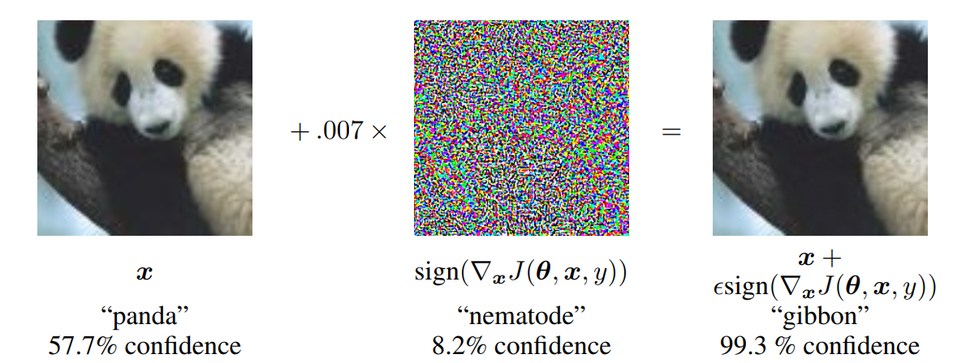


Motivation
Most literature so far focuses on “security” issue, i.e. “malicious” attacker actively seeking misclassification using human imperceptible perturbations
e.g. misclassified Panda

Slide 3
Motivation
Neural networks may also simply make low confidence classifications (even in complete absence of malicious attackers)
while they do Not typically inform the user of their specific level of confidence for each specific classification event

Slide 4
Attack and Defense
Attack：How to generate adversarial example
Goal: find small perturbations that can fool classifiers
Often network specific and example specific heuristics
The smaller the perturbation, the stronger the attack
Defense: How to improve robustness to adversarial examples?
Goal: want a classifier robust to adversarial examples while generalizing well
Current mainstream approach : adversarial (re)training
E.g. augment the adversarial examples into training data

Slide 5



Evaluating Robustness
How to measure the robustness of a neural network?
Intuitively, we can use the distortion of adversarial examples found by a certain attack algorithm as a robustness metric.
Run every attack we know is not enough (there might be more advanced attacks we don’t know)
The measurement should be independent to attack algorithms!
Typically posed as optimization problem:
For a given network, find the maximum perturbation radius not causing miss-classification
Compute the exact minimum adversarial distortion is very hard
$$r$$
$$x_{0}$$
$Co$rrectly classified

Slide 6


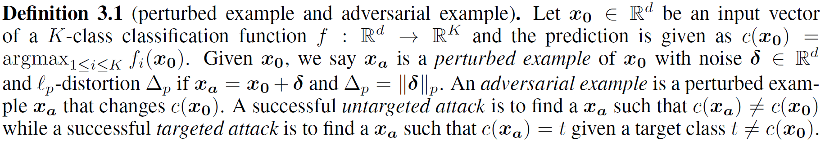




Evaluating Robustness
$$r$$
$$x_{0}$$
$Co$rrectly classified

Slide 7
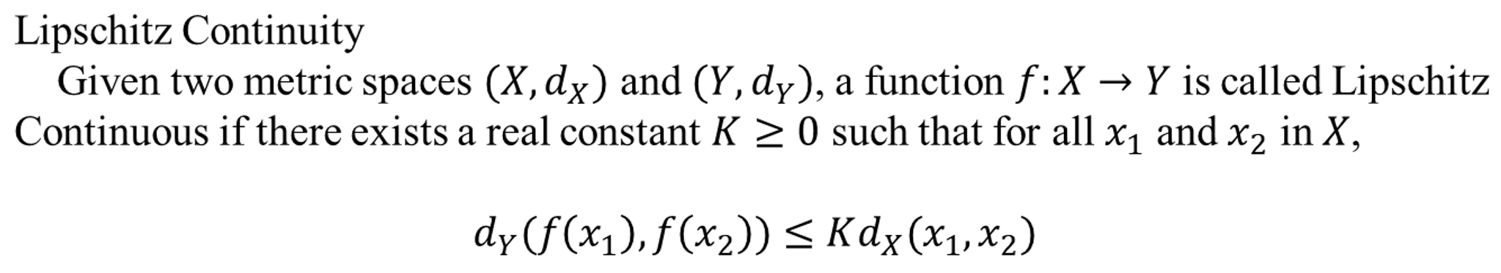
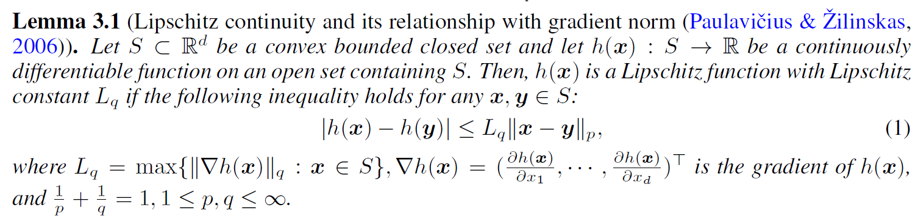
An estimated robustness score
Key Idea: Use Lipschitz constant to characterize the radius of safety region (p-norm ball)
Local Lipschitz constant

Slide 8


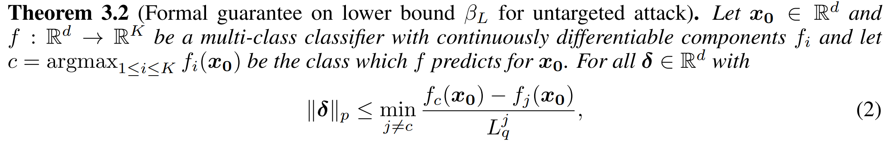
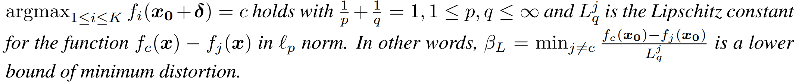
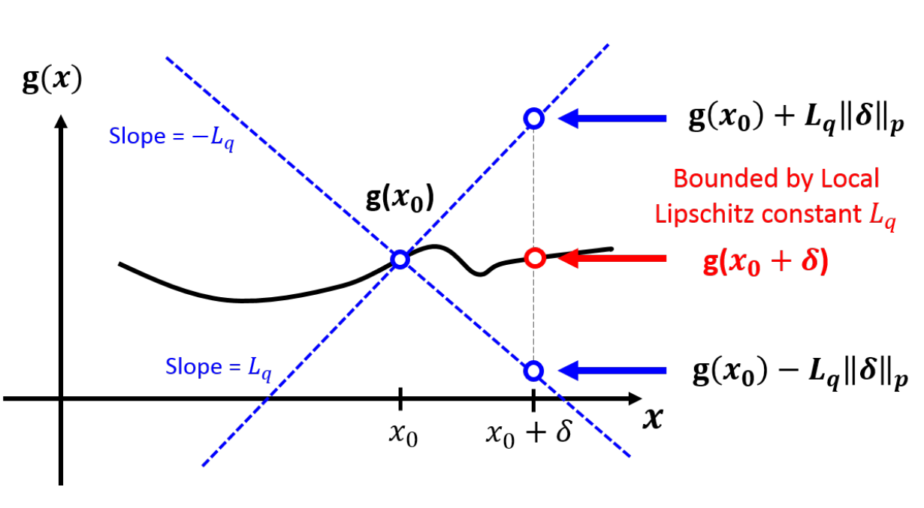
An estimated robustness score
1. Untargeted Robustness

Slide 9
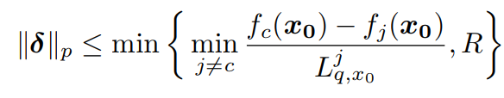




An estimated robustness score
1. Untargeted Robustness
Untargeted Robustness over ball $B_{p}(x_{0},R)$
$$r$$
$$x_{0}$$
$Co$rrectly classified

Slide 10

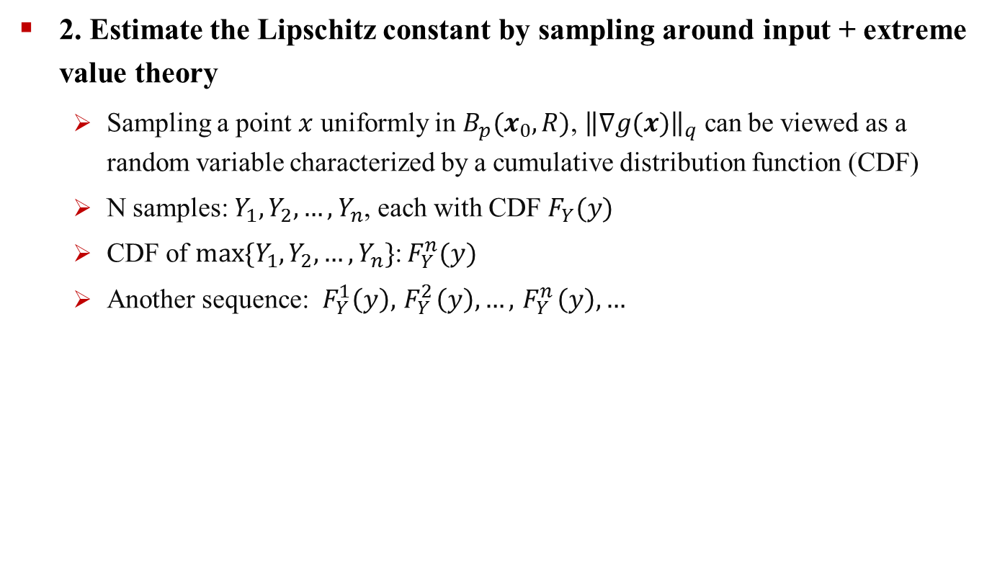

An estimated robustness score
2. Estimate the Lipschitz constant by sampling around input + extreme value theory
Sampling a point $x$ uniformly in $B_{p}(x_{0},R)$, ${\left\|∇g(x)\right\|}_{q}$ can be viewed as a random variable characterized by a cumulative distribution function (CDF)
N samples: $Y_{1},Y_{2}, …,Y_{n}$, each with CDF $F_{Y}(y)$
CDF of $max⁡\{Y_{1},Y_{2}, …,Y_{n}\}$:${ F}_{Y}^{n}(y)$
Another sequence: ${ F}_{Y}^{1}\left(y\right),{ F}_{Y}^{2}\left(y\right),…,{ F}_{Y}^{n}\left(y\right), …$
Fisher-Tippett-Gnedenko Theorem
MLE
Estimate of Local Lipschitz constant $L_{q,x_{0}}^{j}$

Slide 11
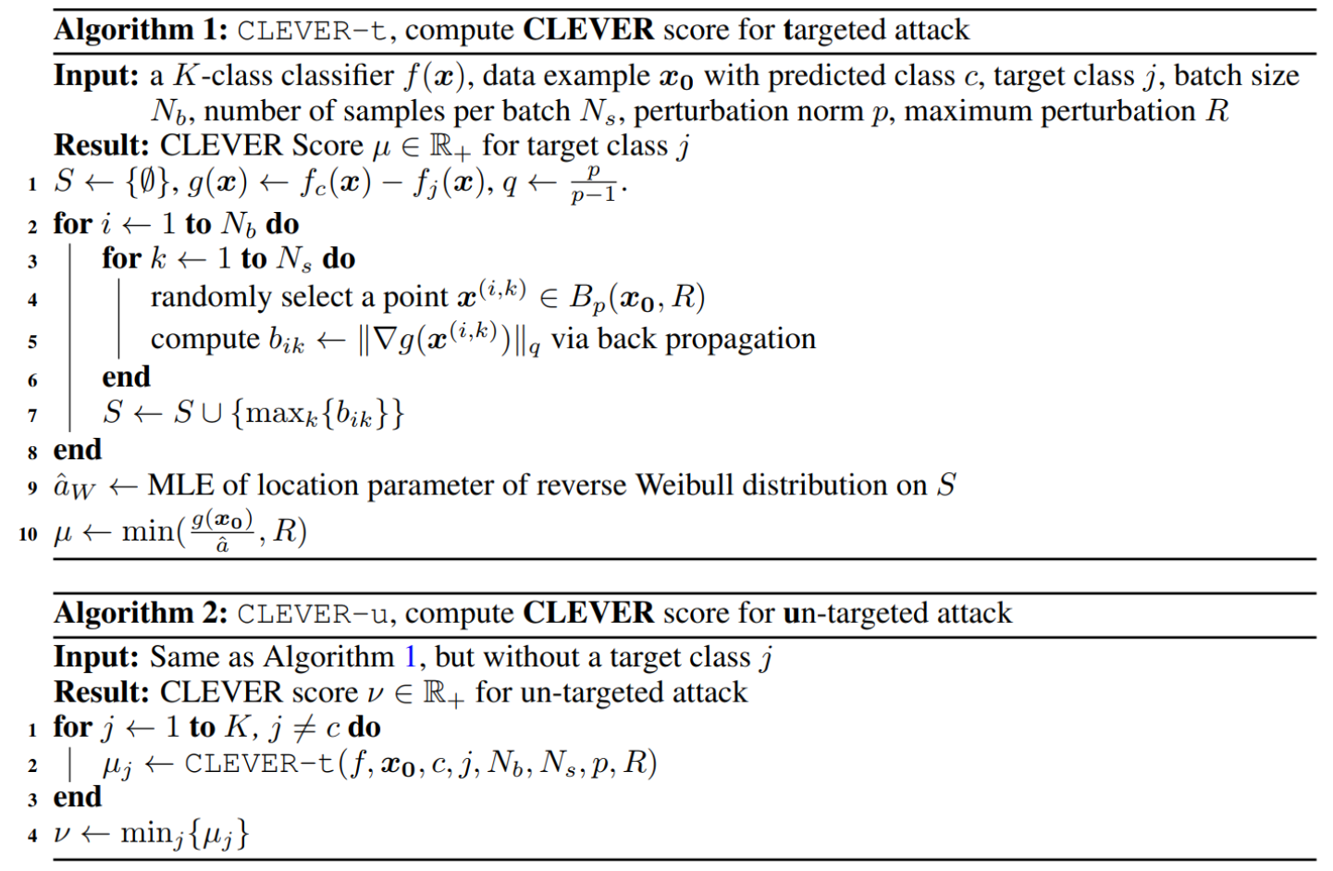
An estimated robustness score
2. Estimate the Lipschitz constant by sampling around input + extreme value theory

Slide 12
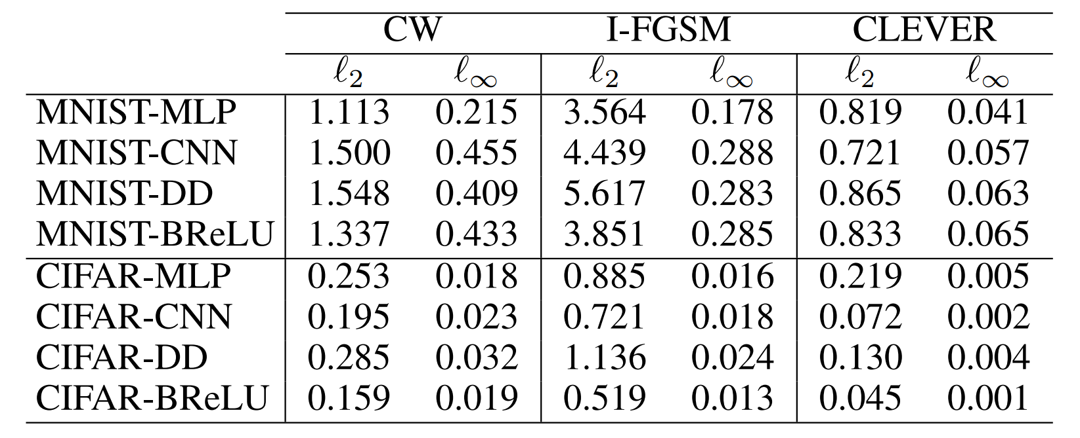
Experiments
Comparing CLEVER with other attack-specific network robustness

Slide 13
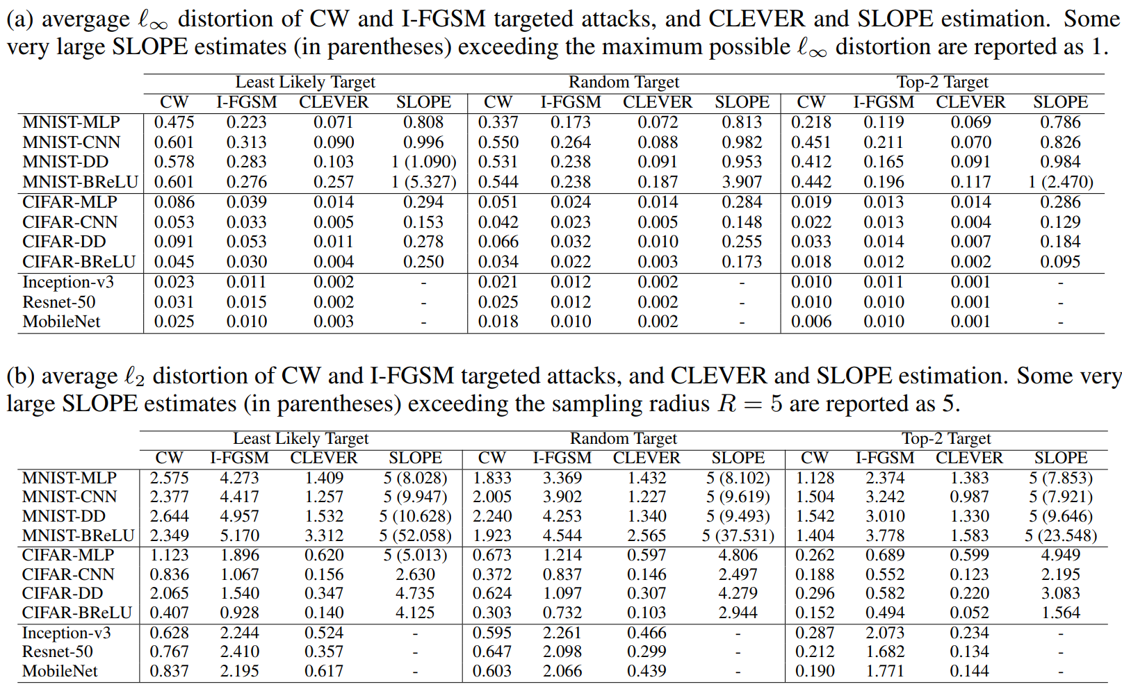
Experiments

Slide 14
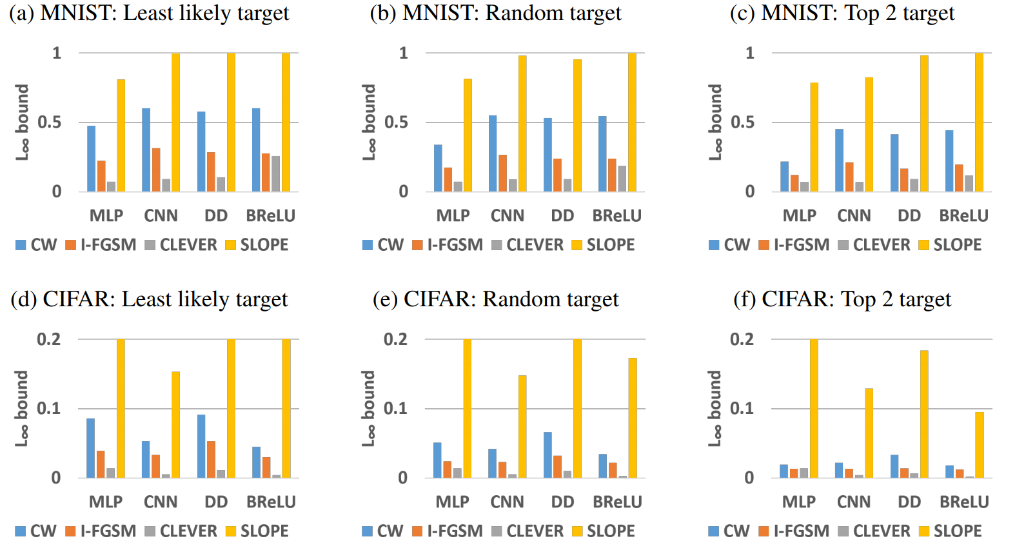
Experiments
Comparison with other Lipschitz constant estimation algorithm (SLOPE)

Slide 15
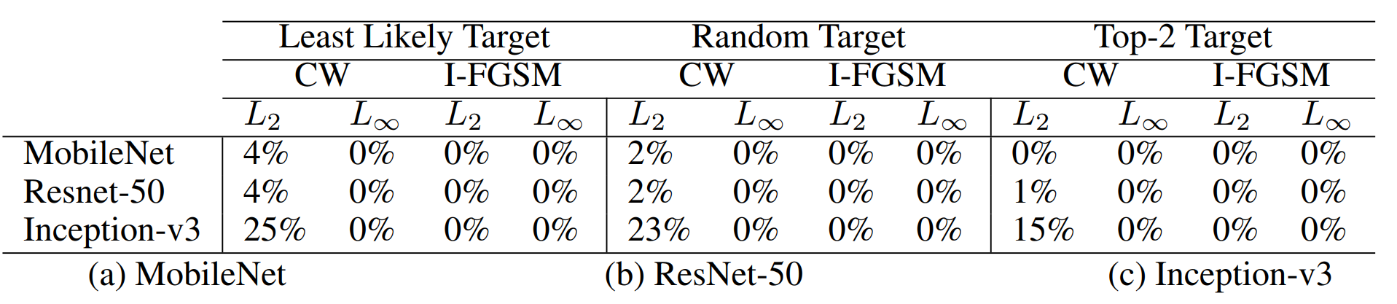
Experiments
Percentage of images in ImageNet where the CELVER score for that image is greater than the adversarial distortion found by different attacks

Slide 16
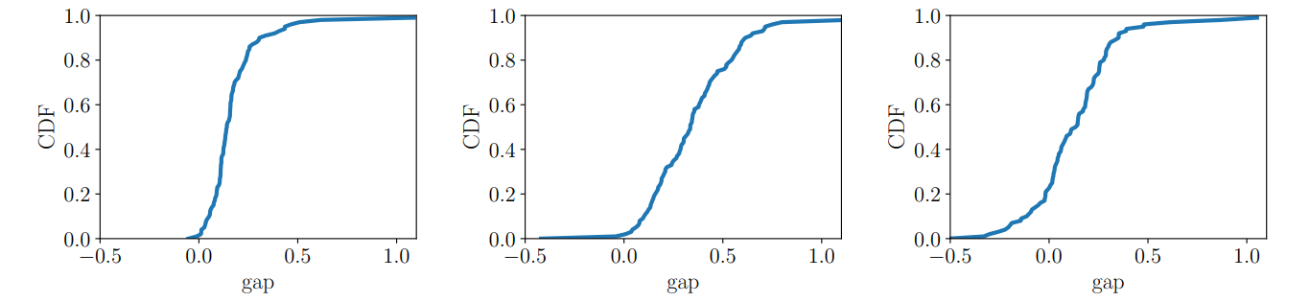

Experiments
The empirical CDF of the gap between CLEVER score and the $l_{2}$ norm of adversarial distortion generated by CW attack with random targets for 100 images on 3 ImageNet networks

Slide 17
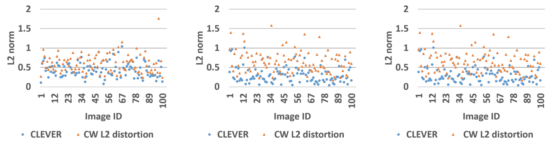

Experiments
Comparison of the CLEVER scores (circle) and the $l_{2}$ norm of adversarial distortion generated by CW attack (triangle) with random targets for 100 images.

Slide 18
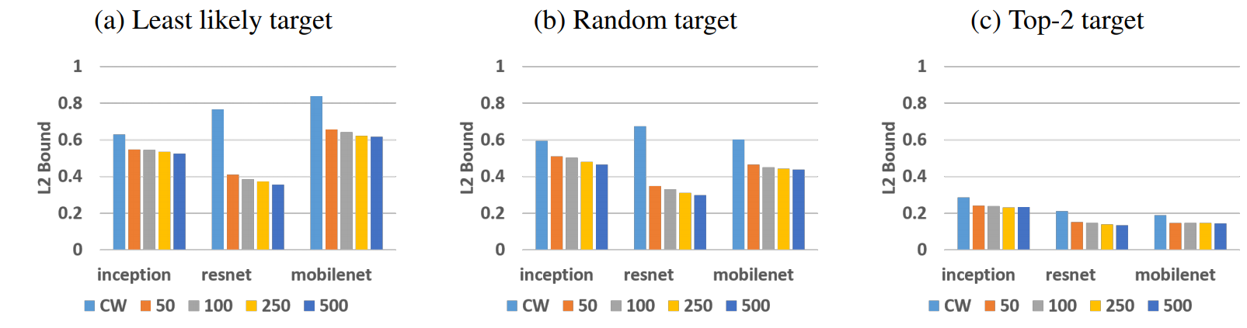

Experiments
Comparison of the CLEVER score calculated by $N_{b}$={50, 100, 250, 500} and the $l_{2}$ norm of adversarial distortion found by CW attack (CW) on 3 ImageNet models and 3 target types.

